Slide 1
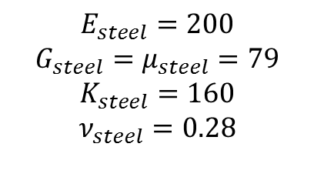
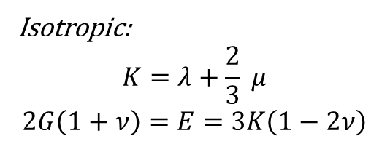

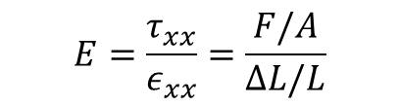
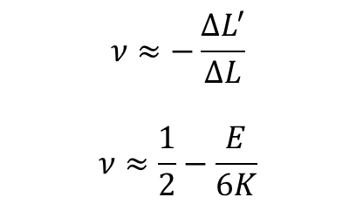











$$L$$
$$L$$
$$ΔL′$$
$$ΔL′′$$
$$ΔL$$
$$x$$
$$L+ΔL$$
$$y$$
$$z$$
Isotropic:
$$K=λ+\frac{2}{3} μ$$
$$2G\left(1+ν\right)=E=3K\left(1−2ν\right)$$
$$K=−V\frac{dP}{dV}$$
$$E_{steel}=200$$
$$G_{steel}=μ_{steel}=79$$
$$K_{steel}=160$$
$$ν_{steel}=0.28$$
$$V$$
$$σ=2με+λ Tr\left(ε\right)I$$
$$V−ΔV$$
$$E=\frac{τ_{xx}}{ε_{xx}}=\frac{F/A}{ΔL/L}$$
$$ν≈−\frac{ΔL^{′}}{ΔL}$$
$$ν≈\frac{1}{2}−\frac{E}{6K}$$

Slide 2


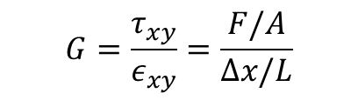


$$G=\frac{τ_{xy}}{ε_{xy}}=\frac{F/A}{Δx/L}$$
$$Δx$$
$$A$$
$$L$$
$$θ$$

Slide 3
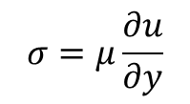

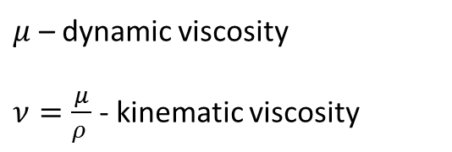
$μ$ – dynamic viscosity
$ν=\frac{μ}{ρ }$ - kinematic viscosity
$$σ=μ\frac{∂u}{∂y}$$
$${\vec{u}}_{plate}$$
Fluid velocity
Stationary plate

Slide 4
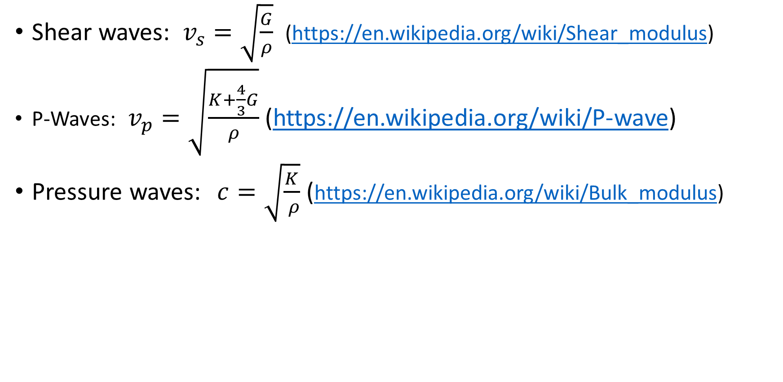
Waves
Shear waves: $v_{s}=\sqrt{\frac{G}{ρ}}$ (https://en.wikipedia.org/wiki/Shear_modulus)
P-Waves: $v_{p}=\sqrt{\frac{K+\frac{4}{3}G}{ρ}}$ (https://en.wikipedia.org/wiki/P-wave)
Pressure waves: $c=\sqrt{\frac{K}{ ρ}}$ (https://en.wikipedia.org/wiki/Bulk_modulus)

Slide 5

Nomenclature
Lame parameters: (https://en.wikipedia.org/wiki/Lam%C3%A9_parameters)
$λ$ Lame’s first parameter
$μ$ Lame’s second parameter
Dynamic viscosity – in fluids
Shear modulus – in elasticity

Slide 6
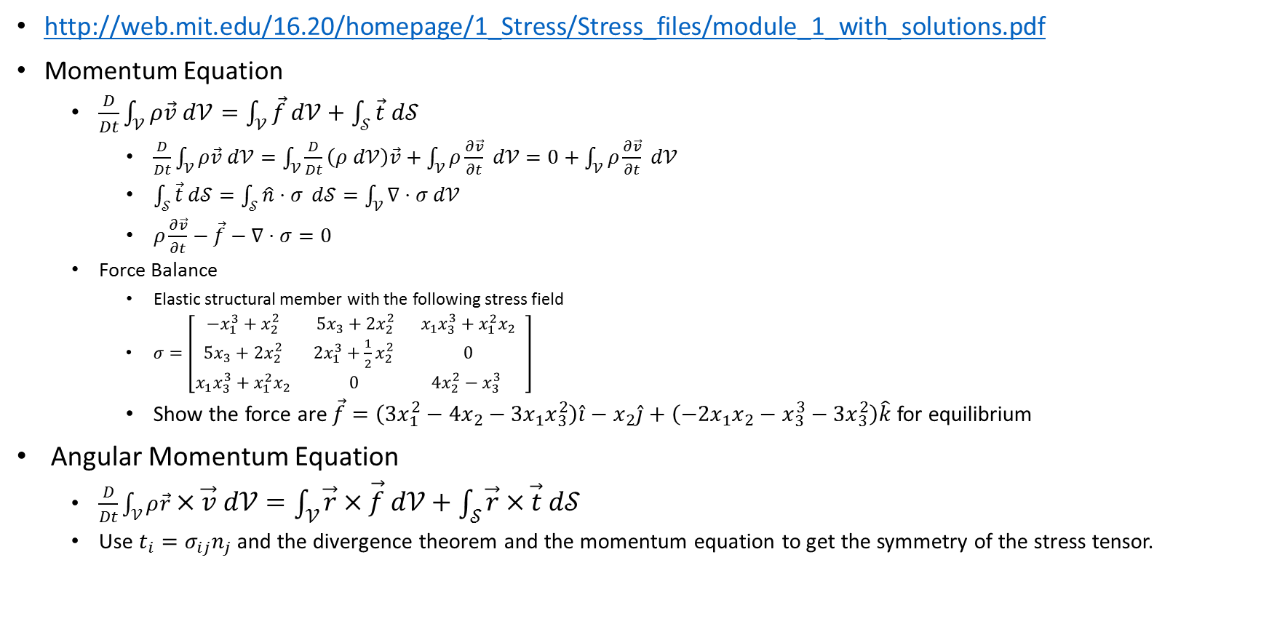
Stress Basics
http://web.mit.edu/16.20/homepage/1_Stress/Stress_files/module_1_with_solutions.pdf
Momentum Equation
$\frac{D}{Dt}\int_{𝒱}{ρ\vec{v} d𝒱}=\int_{𝒱}{\vec{f} d𝒱}+\int_{𝒮}{\vec{t} d𝒮}$
$\frac{D}{Dt}\int_{𝒱}{ρ\vec{v} d𝒱}=\int_{𝒱}{\frac{D}{Dt}\left(ρ d𝒱\right)\vec{v}+\int_{𝒱}{ρ\frac{∂\vec{v}}{∂t}} d𝒱}=0+\int_{𝒱}{ρ\frac{∂\vec{v}}{∂t}} d𝒱$
$\int_{𝒮}{\vec{t} d𝒮}=\int_{𝒮}{\hat{n}⋅σ} d𝒮=\int_{𝒱}{∇⋅σ d𝒱}$
$ρ\frac{∂\vec{v}}{∂t}−\vec{f}−∇⋅σ=0$
Force Balance
Elastic structural member with the following stress field
$σ=\left[\begin{matrix}−x_{1}^{3}+x_{2}^{2} & 5x_{3}+2x_{2}^{2} & x_{1}x_{3}^{3}+x_{1}^{2}x_{2} \\ 5x_{3}+2x_{2}^{2} & 2x_{1}^{3}+\frac{1}{2}x_{2}^{2} & 0 \\ x_{1}x_{3}^{3}+x_{1}^{2}x_{2} & 0 & 4x_{2}^{2}−x_{3}^{3} \end{matrix} \right]$
Show the force are $\vec{f}=\left(3x_{1}^{2}−4x_{2}−3x_{1}x_{3}^{2}\right)\hat{i}−x_{2}\hat{j}+\left(−2x_{1}x_{2}−x_{3}^{3}−3x_{3}^{2}\right)\hat{k}$ for equilibrium
Angular Momentum Equation
$\frac{D}{Dt}\int_{𝒱}{ρ\vec{r}×\vec{v} d𝒱=\int_{𝒱}{\vec{r}×\vec{f} d𝒱}+\int_{𝒮}{\vec{r}×\vec{t} d𝒮}}$
Use $t_{i}=σ_{ij}n_{j}$ and the divergence theorem and the momentum equation to get the symmetry of the stress tensor.

Slide 7
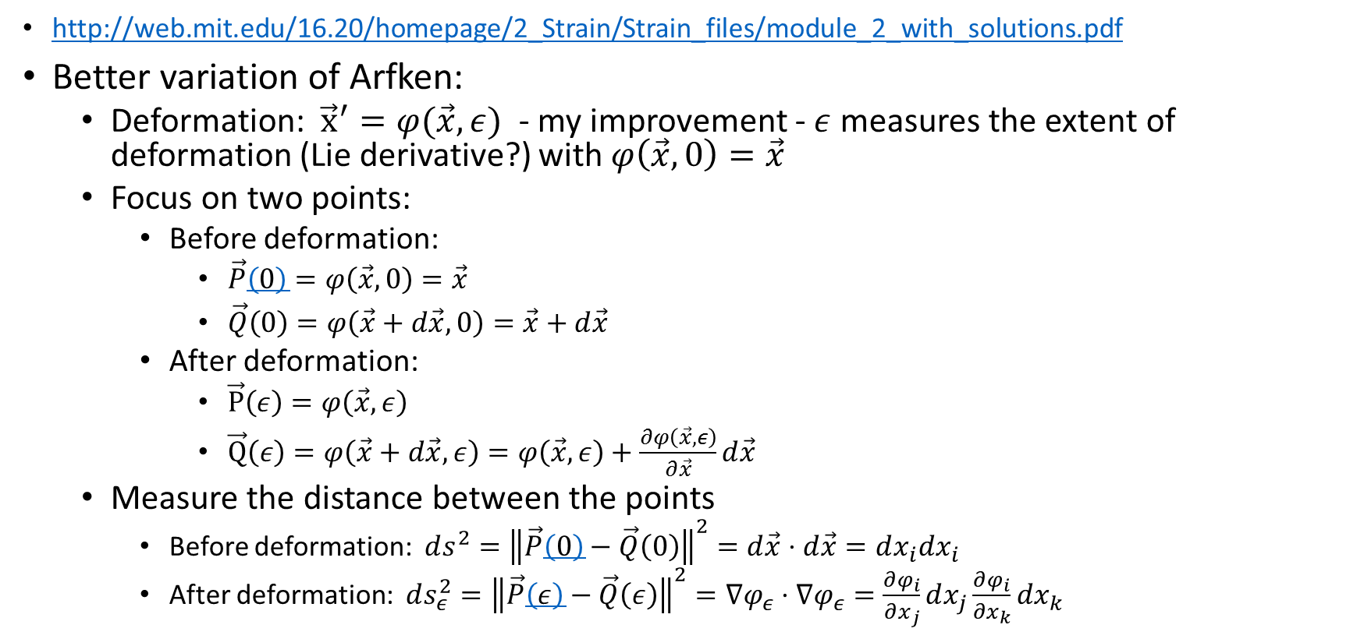
Strain Basics (1/2)
http://web.mit.edu/16.20/homepage/2_Strain/Strain_files/module_2_with_solutions.pdf
Better variation of Arfken:
Deformation: ${\vec{x}}^{′}=φ(\vec{x},ε)$ - my improvement - $ε$ measures the extent of deformation (Lie derivative?) with $φ\left(\vec{x},0\right)=\vec{x}$
Focus on two points:
Before deformation:
$\vec{P}\left(0\right)=φ\left(\vec{x},0\right)=\vec{x}$
$\vec{Q}\left(0\right)=φ\left(\vec{x}+d\vec{x},0\right)=\vec{x}+d\vec{x}$
After deformation:
$\vec{P}\left(ε\right)=φ\left(\vec{x}, ε\right)$
$\vec{Q}\left(ε\right)=φ\left(\vec{x}+d\vec{x},ε\right)=φ\left(\vec{x},ε\right)+\frac{∂φ\left(\vec{x},ε\right)}{∂\vec{x}}d\vec{x}$
Measure the distance between the points
Before deformation: $ds^{2}={\left\|\vec{P}\left(0\right)−\vec{Q}\left(0\right)\right\|}^{2}=d\vec{x}⋅d\vec{x}=dx_{i}dx_{i}$
After deformation: $ds_{ε}^{2}={\left\|\vec{P}\left(ε\right)−\vec{Q}\left(ε\right)\right\|}^{2}=∇φ_{ε}⋅∇φ_{ε}=\frac{∂φ_{i}}{∂x_{j}}dx_{j}\frac{∂φ_{i}}{∂x_{k}}dx_{k}$

Slide 8
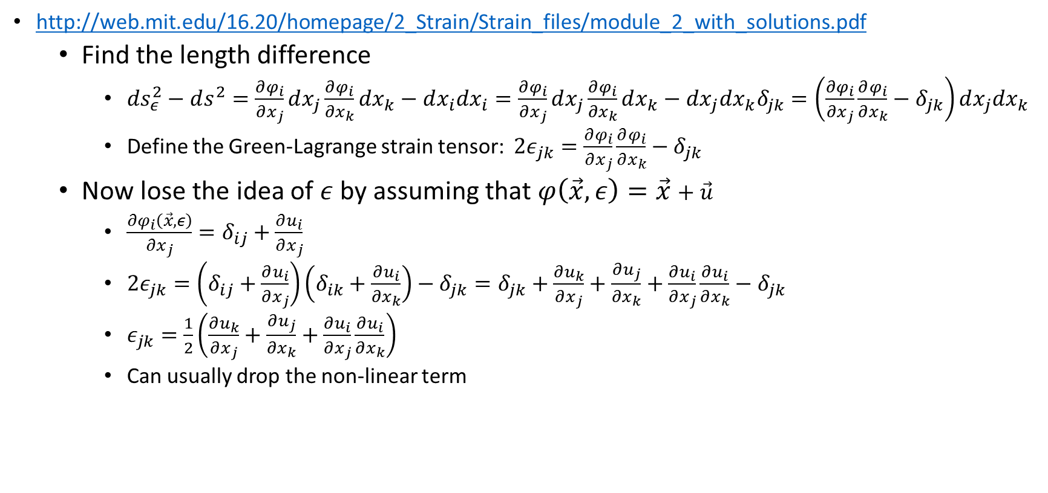
Strain Basics (2/2)
http://web.mit.edu/16.20/homepage/2_Strain/Strain_files/module_2_with_solutions.pdf
Find the length difference
$ds_{ε}^{2}−ds^{2}=\frac{∂φ_{i}}{∂x_{j}}dx_{j}\frac{∂φ_{i}}{∂x_{k}}dx_{k}−dx_{i}dx_{i}=\frac{∂φ_{i}}{∂x_{j}}dx_{j}\frac{∂φ_{i}}{∂x_{k}}dx_{k}−dx_{j}dx_{k}δ_{jk}=\left(\frac{∂φ_{i}}{∂x_{j}}\frac{∂φ_{i}}{∂x_{k}}−δ_{jk}\right)dx_{j}dx_{k}$
Define the Green-Lagrange strain tensor: $2ε_{jk}=\frac{∂φ_{i}}{∂x_{j}}\frac{∂φ_{i}}{∂x_{k}}−δ_{jk}$
Now lose the idea of $ε$ by assuming that $φ\left(\vec{x},ε\right)=\vec{x}+\vec{u}$
$\frac{∂φ_{i}\left(\vec{x},ε\right)}{∂x_{j}}=δ_{ij}+\frac{∂u_{i}}{∂x_{j}}$
$2ε_{jk}=\left(δ_{ij}+\frac{∂u_{i}}{∂x_{j}}\right)\left(δ_{ik}+\frac{∂u_{i}}{∂x_{k}}\right)−δ_{jk}=δ_{jk}+\frac{∂u_{k}}{∂x_{j}}+\frac{∂u_{j}}{∂x_{k}}+\frac{∂u_{i}}{∂x_{j}}\frac{∂u_{i}}{∂x_{k}}−δ_{jk}$
$ε_{jk}=\frac{1}{2}\left(\frac{∂u_{k}}{∂x_{j}}+\frac{∂u_{j}}{∂x_{k}}+\frac{∂u_{i}}{∂x_{j}}\frac{∂u_{i}}{∂x_{k}}\right)$
Can usually drop the non-linear term

Slide 9
Constitutive Relations
http://web.mit.edu/16.20/homepage/3_Constitutive/Constitutive_files/module_3_no_solutions.pdf

Slide 10
http://spin.ap.columbia.edu/msae4215/ch06mod.html

